Slide 1


Online Machine Learning Techniques for Predicting Operator Performance
MASTER’S THESIS BY
AHMET ANIL PALA
Thesis Advisor: MAX HEIMEL
Thesis Supervisor: Prof. Dr. VOLKER MARKL September 3rd, 2015

Slide 2
Agenda
Motivation
Problem
Existing Methods
Approach
Evaluation
Summary

Slide 3
Tuning a hardware-oblivious database
Tuning a hardware-oblivious database involves two decision-making tasks
Device Selection
Algorithm Selection
hash-based join
sort-merge join
nested-loop join
Notes:
Justify why online machine learning is needed for op. runtime prediction? In order to answer this question, gotta tell about the internals of Ocelot.
As Ocelot has a hardware-oblivious design, it does not ship with the hardware-dependent optimizations. Instead it tries adapts to the platform it is running on at the runtime.
For every operator call, it has to choose an algorithm among the ones available for evaluating the operator and the device to run the algorithm code on. For example,

Slide 4
Device Selection
Notes:
Device selection logic considers the run time statistics, device load and inter-device transfer times which is important as where the output of the previous operator is hosted

Slide 5
Algorithm Selection
Notes:
As for the alg selection, the aim is to select ‘probably’ the fastest operator algorithm on the selected device given the operator features. For this estimating the cost available algorithms would incur is an essential task. To this end, predictive cost models for each algorithm-device pair is stored. This answers why learning approaches are needed. However, I am still yet to answer the question why online?

Slide 6
Algorithm Selection
Notes:
After an algorithm chosen, the runtime of the algorithm is measured and with this measurement the cost model for this algorithm is updated.

Slide 7
Learning Scenario
Notes:
From the perspective of cost model, it makes runtime predictions given the feature sets and requested to update itself with the measurement data in succession. The learning scenario with the runtime estimator module represents the characteristics of stream learning where the data stream elements consist of feature sets and the measurements. But why do we keep updating even after the cost model becomes a good predictor of the runtime of the operator algorithm?

Slide 8
Concept Drifts
Notes:
If we take a deeper look at the Ocelot design, we see that every algorithm is implemented by a vast number of variants which are different flavors of the algorithms. For example, the nested-loop join algorithm can be implemented using loop unrolling or without loop unrolling. Ocelot on the fly substitutes the variant that gets to execute when a certain algorithm is chosen in an attempt to find the most optimal variant. However, this variant substitution layer is hidden from the runtime estimation and algorithm selection layers. What this means is that the data generation function here that generates the data points which corresponds to the feature sets and the targets which correspond to the measurement are subject to change. Therefore the predictive models have to respond to such changes. This phenomenon is called concept drift. In this case concept drifts are abrupt. So we are only interested in abrupt concept drifts. Batch learning algorithms cannot cope with concept drifts necessitating the use of online learning algorithms.

Slide 9
Online Regression Problem
Target
Data point
Noise
Design Matrix (n-by-d)
Targets vector (n-by-1)
Find
Notes:
This is the formal definition of the online regression problem. We have potentially infinitely many ordered datapoint-target pairs. We assume targets are determined by a hidden function generation function but also contaminated by measurement noise. We assume the noise is homosccedastic input independent and Gaussian distributed. We want to predict the target for the next data point given the data available.

Slide 10
Learning Model Requirements
High Accuracy
Robust to Abrupt Concept Changes
Robust to Measurement Noise
Provide Estimation Bounds
Constant Space
Efficiency (≤ 1ms/item)
Notes:
In addition to the formal definition of the problem at hand, there are some requirements that an online regression method to meet to be employed in Ocelot. These are listed here.
Talk about efficiency and estimation bounds (could be prediction intervals or confidence intervals) , refer abrupt concept drifts and measurement noise to the previous slides.

Slide 11
Learning Models
Parametric models
MAP-method
MLE-method
Non-parametric models
Gaussian Process Regression
Kernel Regression
Notes:
The learning problem we are dealing with is ‘regression estimation’ or ‘function approximation’ problem as we are interested in predicting the return value of the function that is assumed to generate the data (called regression function) given the inputs in order to support decision-making layers of the Ocelot. The regression methods proposed In the literature can be divided into two categories namely the parametric models and non-parametric models. Out of many regression algorithms investigated, 2 parametric and 2 non-parametric models were promising for fulfilling the requirements mentioned.
(Give heads up here)

Slide 12
Parametric models
Aim is to find !
Notes:
Parametric models assume that the regression function that generates the data can be written in THIS form which is linear in parameters w.
Note that, being linear in parameters, doesn’t mean that the assumed data generation function can only be linear. By defining a set of base functions that maps inputs to a feature-space, one can write non-linear functions which are actually linear in their params.
The prediction mechanism of the parametric models is estimating the parameters of the data generation function from the past data points and and once the parameters are inferred, reproduce the data generation scenario to predict the target values given the inputs.

Slide 13
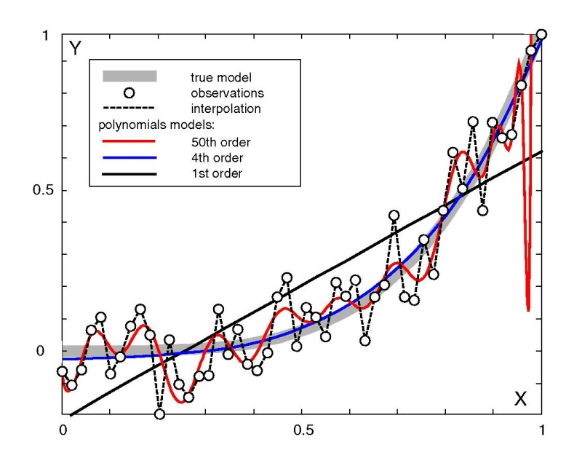
MLE/MAP methods
regularization term
Image taken from http://pvermees.andropov.org/noble/disc/discPaper/node19.html
Notes:
The simplest parametric algorithm is the MLE method. It defines a function of w that measures the distance between the observed targets and the fitted curve. The parameters that minimizes this distance is the MLE-method.
However, the trouble that can occur with MLE method is that, as it tries to fit the data as good as it could given the observations, it can fit the measurement error that is present in the data. In order to avoid this, regularization term is introduced in the parameter estimation formula. Thanks to this term, parameter estimation becomes less sensitive to the fluctuations in the measurements and simpler models are favored over the complex ones.
The second term in the sum is called the regularization term and sigma_y is the stdev of the measurement noise which is modeled as a mult. Gaussian and the capital sigma squared is the variance-covariance matrix of the data points. These both are hyperparameters and need to be tuned.

Slide 14
Non-parametric Models
Data-driven
Accumulative
case base
Notes:
Now I will give a quick overview of the non-parametric learning models that we considered. Non-parametric algorithms do not assume anything about the data generation function. Therefore, the trouble that the parametric models can have when their assumption about the data generation function is not valid is avoided altogether. In the absence of the parameters, their prediction mechanism is totally different than that of parametric models. Generally speaking, for a given data point whose not-yet-observed target to be predicted, the prediction is delivered as the weighted sum of the the observed targets of the accumulated data points.

Slide 15
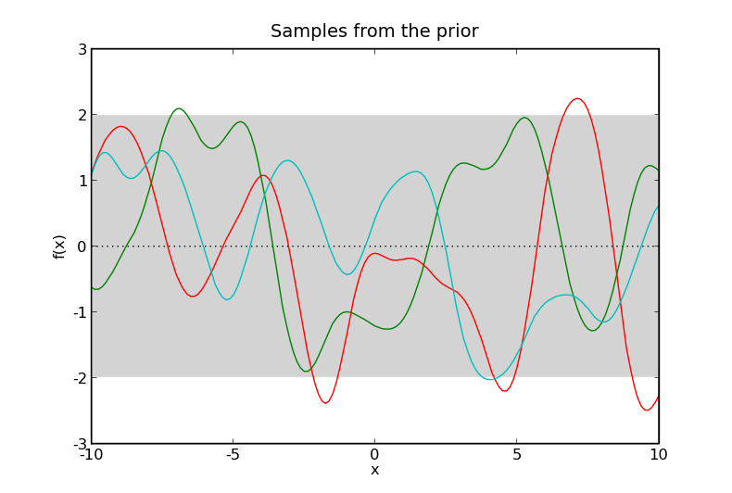
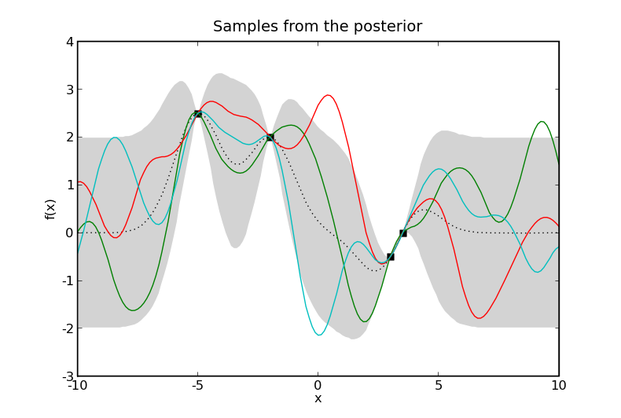
Gaussian Process Regression
All targets as a single point in Gaussian distribution
Considering the functions that can map data points to the observed targets in the function space
Images taken from http://pythonhosted.org/infpy/gps.html
Notes:
GPs are very powerful tools for modelling. When employed for regression, all the observed and unobserved targets are considered to be a single point sampled from multivariate Gaussian distribution. Moreover, from the infinitely many functions that are allowed by the prior defined over the function space, only the ones that can map the data points to the observed targets are considered for the prediction. For a new data point, the point prediction made is the aggregation of the return values of the considered functions for a given data point. As for the prediction bounds need to be estimated, since all the targets are multivariate Gaussian distributed with known mean vector and covariance matrix, the predicted and not-yet observed target can be seperated from that mult. Gaussian using the conditioning property of the Gaussians. This way, the predicted target can be written as a normal distributed random variable with a mean and variance where the mean is the point prediction. The variance then can be used to estimate the prediction bounds.

Slide 16
Kernel Regression
Based on kernel-density estimation
Generalization of k-NN method
can be seen as bins
Graph taken from Silverman, Bernard W. Density estimation for statistics and data analysis.
Notes:
The other non-parametric regression algorithm used is Kernel regression. Kernel regression is based on the kernel density estimation. The derivation of kernel density estimation is similar to that of histogram building in multiple dimensions but instead of counting the occurrences of data points in the bins that are defined for each unit grid in the input space, each data point itself defines a bin and its containment by the bins of the other data points gives an estimate of the density of the point which the said data point sits at.
As for the kernel regression, as previously said, the predicted target can be written as the weighted sum of the observed targets and the weights here correspond to the amount of the contribution of the stored data points to the density estimate of a new data point. This approach can be seen as a generalization of the knn.

Slide 17
Approach
Incremental update mechanism
Removal of obsolete examples (downdate)
Notes:
These algorithms overviewed are commonly used for the regression problems in batch setting and produce good results. However, their prediction mechanism needs to be reimagined to be employed in an online learning scenario. This is the main contribution of the thesis.
The main challenge of designing regression algorithms that can handle potentially drifting stream data is incorporating new data points into the predictive model without retraining the predictive model from scratch. The main reason for avoiding the retraining is obviously the efficiency. As previously mentioned in the required properties of the learning algorithm, the predictions needs to be fast and accurate. This implies the predictive model should be updated quickly with new measurements.
In addition to incorporating new data points, another equally challenging and crucial challenge was to eliminate the effect of the data points that might have become obsolete from the predictive model.
These two operations are called ‘update’ and ‘downdate’ respectively but they are implemented in the same routine called ‘update’ In addition to the ‘update’ routine, the ‘predict’ routine that delivers the point predictions and prediction bounds estimations for a given data point and ‘tune’ routine that calibrates the online learner according to the data observed until the point of tuning is implemented.
However, I will not go into the implementation details of these routines as they involve derivations of recursive formulations which can be found in the thesis. Instead I will present high-level design ideas that we used for the implementation
We used two different designs for the implementation of online learners based on the regression algorithms discussed.

Slide 18
Sliding-windowed design
Notes:
First of this two is the sliding-windowed design. This design can be used for learning algorithms that depend on the past data for either making point predictions or estimating the prediction bounds. The main idea is to store most recent k data points in most-recent to least-recent order in a structure called sliding window. Moreover, with every new data point arrive from the stream, the least recent data point from the tail of the window is dropped and the window items are slid by one position to the tail making space for the most recent data point in the head position of the stream. The data available to the learning algorithm for delivering predictions with prediction bounds is the data stored in the sliding-window. As sliding window stores the most recent data points, the adaptation to emerging concepts is automatic. Furthermore, as the sliding-window size is fixed throughout the lifetime of the online learner, the space it occupies can always be bounded by a constant which is a desirable property in online learning scenario.
In order to realize the mentioned sliding operation (costly if implemented in a naive way) with the new data points arriving, a ring buffer is employed making it possible to slide the window by only modifying two pointers that point to beginning end the end of the buffer.

Slide 19
Sliding-windowed design – state transition diagram
Notes:
The behavior of the sliding windowed online learners depend on their state. In order to illustrate the states, state transition invoking operations and the order by which the update, predict and tune operations follow each other.
(Explain the diagram.)

Slide 20
Forgetting-based design
Notes:
An alternative to the sliding-windowed implementation is the forgetting-based implementation. Forgetting based implementation is memoryless and do not store any of the past data points or observed targets. The main idea is to discount the effect of the less recent data points on the predictive model by means of a forgetting-factor parameter, denoted as α. This way the effect of potentially obsolete data points fade quickly.

Slide 21
Forgetting-based design – state transition diagram
Notes:
…and here is the state transition diagram for the forgetting-based learners. As it is not possible to tune the learner when a memoryless is opted in, the ‘tune’ opearation is naturally not implemented for the forgetting-based learners. Thus, the state transition diagram is pretty simple. (Explain the diagram quickly)

Slide 22
Implementation of ‘predict’ for MLE/MAP learners
instantaneous error
Notes:
A concrete implementation of an online learning either following the sliding-windowed design or the forgetting-based one, update, predict and tune routines need to be implemented. I will only discuss the implementation of these routines that do not involve much formulation due to the time constraints. However, you can always refer to the thesis itself.
I will now briefly discuss the predict routines implemented for MAP and MLE. Making point predictions, using the parameters maintained by the online learner, is just a matter of calculating the product of parameters and the data point to obtain the point prediction.
As for the prediction bound estimations, MLE method provides a way for estimating asymptotical prediction intervals but its calculation depends on the squared sum of the error that the online learner ‘would’ make for the past data points. Let’s call this ‘instantaneous error’. Therefore, although the MLE method, for inferring the parameters used for making point predictions, use only a d-by-d matrix and do not require storing of the historic data, for computing the instantaneous error, it has to store some of the past data points. Due to this, in order to use the asymptotic prediction intervals as the prediction bounds, MLE method should be implemented following the sliding-windowed design.

Slide 23
3-learner ensemble for estimating prediction bounds for MLE/MAP learners
Notes:
In order to employ MLE method without having to store the historic data or to employ MAP method which doesn’t have support for the asymptotical prediction interval unlike MLE, we came up with an alternative prediction bounds estimation method.
The idea is maintaining three versions of the online learner one of which is called the base learner and the other two are the upper bound learner and the lower bound learner. The learner system consists of these three learners is called 3-learner ensemble. The point predictions made by the base learner is returned as the point prediction for a data point for which the target prediction is requested. As for the bounds, the bound learners provide the the upper and the lower bound of the predictions. In order to make this prediction scenario possible, these three learners should be updated with different set of data points after a predefined burn-in time. After the burn-in, the upper bound learner is updated with the data points with observed targets that are higher than the the lower bound prediction made made by the 3-learner ensemble. Similarly, the lower bound learner is updated with the data points with observed targets that are lower than the the upper bound prediction made by the 3-learner ensemble.

Slide 24
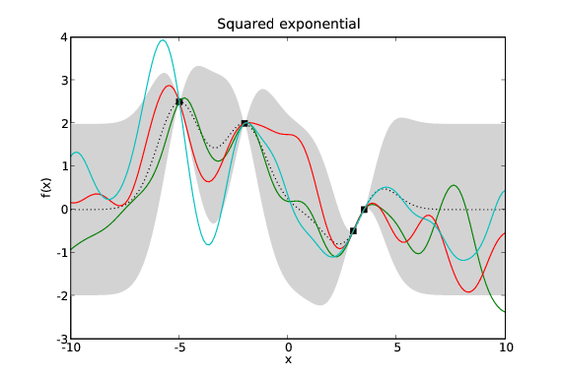
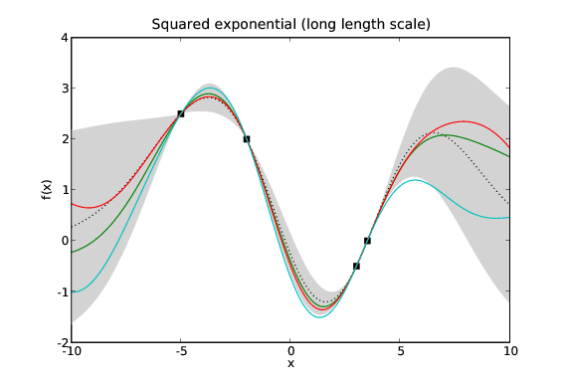
Implementation of ‘tune’ for GP Regression
signal variance
characteristic lengthscale matrix
noise variance
Images taken from http://pythonhosted.org/infpy/gps.html
Notes:
Now I will talk about the tuning routines implemented for non-parametric learners.
GP Regression implementation employs a kernel function that defines the prior over the function space I’ve mentioned. This kernel function has some parameters need to be picked for a concrete implementation. These are considered to be the hyperparameters of the learning algorithm. The most interesting hyperparameter is the characteristic lengthscale matrix D. Characteristic lengthscales are in effect used to normalize the input dimensions with too spread or too tight distributions. Thanks to this, the irrelevant input dimensions can be ignored.
THESE two figures illustrate how a different lengthscale can change the function chosen from the function space to come up with point predictions and prediction bounds.

Slide 25
Implementation of ‘tune’ for GP Regression
constant
complexity penalty
data-fit
Graph taken from Williams, Christopher KI, and Carl Edward Rasmussen. "Gaussian processes for machine learning." the MIT Press 2.3 (2006): 4.
Notes:
Finding a good combination of the hyperparameters is an essential task. With a bad choice of the hyperparameters, predictions made and the prediction intervals estimated will not be in accurate.
Bayesian inference framework provides a target function called log-marginal likelihood with interpretable terms such as complexity penalty and the data-fit which affords an automatic trade-off between model complexity and the accuracy. This is a function of hyperparameters hence the tuning task here is to find the parameter setting that maximizes the target function.
Fortunately, the target function here is derivable with respect to the hyperparameters. Therefore, the gradient based optimization algorithms can be used to find the optimal hyperparameters. However, as illustrated in THIS graph, the optimization problem here is a non-convex one. In order to avoid getting stuck at a local optima a hybrid optimization algorithm based on gradient-ascent and random search is implemented.

Slide 26
Implementation of ‘tune’ for Kernel Regression
bandwidth matrix
Image taken from http://pvermees.andropov.org/noble/disc/discPaper/node19.html
Notes:
As for the the tuning of the Kernel regression learner. The density estimation formula which is essential for making predictions has a parameter to be tuned. This parameter is the bandwidth matrix and similarly to the characteristic lengthscales hyperparameter used in the GP Regression, it normalizes the too wide or too narrow data distributions of the input dimensions might have. Finding a good bandwidth matrix is a crucial task. HERE it is depicted how the different choices for the bandwidth can change the smoothness of the prediction line.
Unfortunately this time, there is no derivable target function of the hyperparameter to be maximized. However, Silverman suggested that the bandwidth matrix should be some multiple of the variance-covariance matrix of the data. Therefore, the tuning operation simply computes the var-cov matrix of the data points stored in the sliding window and scans a range of multiples of it that makes the validation error minimum. This operation has a quadratic time complexity.

Slide 27
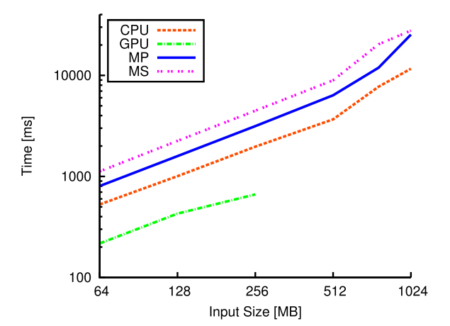
Evaluation
52 Online learners & 12 Batch learners
Rigorous testing on synthetic streams
Image taken from Heimel, Max, et al. "Hardware-oblivious parallelism for in-memory column-stores." Proceedings of the VLDB Endowment 6.9 (2013): 709-720.
Notes:
Now I will talk about the evaluation of the online learners implemented. Total of 52 online learners using different sliding window sizes or forgetting factors or in the case of GP Regression using different mean functions are implemented. Moreover, as a control group 12 batch learners implementing the batch versions of the regression algorithms are implemented.
Only the test results of the implemented learners on the synthetic streams are thoroughly analyzed. And the streams obtained from the measurement data from the running instances of Ocelot on various platforms is used for validation of the observations made by the synthetic testing. The reason for using the synthetic data and actual measurement data for different purposes is that the extra information available about the the properties of synthetic data which is lacking in the case of the real measurement data such as stationary, underlying function, noise levels, etc. This allows to identify the weakness and strengths of the online learning algorithms better.
We have generated 576 datasets of ordered 2000 datapoint-target pairs from which the streams are simulated from. For the half of the datasets, we planted a concept drift starting at the 1000th data point in order to simulate the concept drift scenario. Moreover, In order to mock the runtime behavior of the database operators which typically has discontinuities as shown here, half of the data sets are generated by a discontinuous data generation function which demonstrates a smaller growth rate for the smaller inputs and larger growth rate for the larger ones.

Slide 28
Evaluation
52 Online learners & 12 Batch learners
Rigorous testing on synthetic streams
Evaluation dimensions: accuracy, prediction bounds quality, time efficiency
Accuracy | Prediction Bounds | Time Efficiency
RMSE | ICR | ATPI (ms/item)
RMSE_ST | AIW | Max. Data Rate (item/ms)
SMSE | SAIW
SMSE_ST
Notes:
The implemented learners are evaluated according to three different evaluation dimensions namely blablabla. For each dimension a number of metrics are defined. The major ones are listed in the table.
(Quickly explain the metrics!)
-for time efficiency we have ATPT which stands for blabla and Max Data rate which tells the maximum rate of the stream that an online learner can handle.

Slide 29
Evaluation
52 Online learners & 12 Batch learners
Rigorous testing on synthetic streams
Evaluation dimensions: accuracy, prediction bounds quality, time efficiency
Prequential method and windowed prequential method
Notes:
For carrying out the evaluation, two different evaluation methodology are adopted based on the desired form of the summary statistics. If a number summarizing the learners performance over a single or multiple tests, then the prequential method which simply accumulates the aggregation of the computed metrics for the learner since the beginning of the stream.
On the other hand when the windowed prequential method is employed, the results of the test is in the form of a list of numbers each of which is for the aggregation of the computed statistics for the last w items. Plotting the list of the numbers as the output of the evaluation using this method, the local changes it represent during the course of the stream can be captured. However, when this method is used it does not allow aggregating the results from different tests as aggregating plots do not make sense.

Slide 30
Online Learners vs Batch Learners
Notes:
I present some of the evaluation results aggregated at different levels. Firstly before comparing the online learners within themselves, in order to justify the need for the hassle implementing the online versions of the regression algorithms, a batch vs online learners accuracy comparison is presented
The displayed results are the average SMSE and static SMSE values of the 52 online and 12 batch learners on 288 stream simulations which are simulated from data sets with discontinuities. According to the results, the accuracy gap between batch and online learners for non-static data tests is huge justifying the need for online learners in non-stationary streaming scenarios,

Slide 31
Window size on efficiency
Notes:
THIS graph illustrates the increase in the ATPI score as the window size grows. This holds for all the learners but since MLE and MAP learners are too quick in comparison to the non-parametric learners, they seem to remain unaffected by the window size increase in the graph.

Slide 32
Window size on efficiency
Notes:
in THIS graph we see the declining maximum data rates as the window sizes grow and this holds for all the kinds of learners.

Slide 33
Window size on accuracy
Notes:
HERE is the accuracy comparison of sliding windowed learners with varying window sizes. We see that the static accuracy improves as we increase the window size as indicated by the orange line as expected. However, for general accuracy, same does not hold. This is counterintuitive.

Slide 34
Window size on accuracy
GPWindowedGaussianKernelZeroMean variants with different window sizes on SYNTH_D_CD_2000_4_10_1_24
Notes:
In order to see what is going on with the general accuracy, we looked at the RMSE results from the individual tests.
A side-by-side comparison of individual learners of different window sizes on a single stream reveals the culprit. HERE we see that the learner with the highest window size whose RMSE value is plotted with black is the latest to recover after the scheduled concept drift at the 1000th point in the stream.
This along with the window size implications on the time efficiency suggest that there is a sweet point in the window-size to be chosen from the available window sizes. In our tests window sizes of 64 and 96 were the most promising choices.

Slide 35
3-Ensemble Prediction Bounds Estimation Method Performance
50 sample predictions of BayesianMAPForgettingMapped_FF0.05 on SYNTH_D_CD_2000_1_100_1_12
Notes:
Another observation that we made is the disappointing performance of the 3-Ensemble Prediction Bounds Estimation method used with MAP and MLE forgetting-based learners.
The average ICR value of these learners was 0.3 meaning only 30% of the targets are contained in the prediction intervals estimated by the 3-Ensemble method. In order to see how low this is, from a single test, 50 random predictions of a forgetting-based learner along with the prediction intervals is visualized.
As we see the prediction bounds most of the time do not contain the observed target. This on its own is a good reason to conclude that the forgetting-based learners do not meet our requirements.

Slide 36
MAP/MLE on streams with continuous and non-discontinuous data
Notes:
In THIS graph we see aggregated SMSE, SAIW and ICR scores indicated by blue, grey and yellow bars respectively for MAP and MLE learners. The darker bars are for the test results aggregated from 288 streams with no discontinuities and lighter bars are for the test results aggregated from 288 streams with discontinuities.
We see that MAP and MLE based learners do not perform satisfactorily on the streams generated from the functions with discontinuities in both accuracy and in the average interval width. We see that for a good coverage of the observed targets, the parametric models provide very large prediction intervals that are even bigger than the overall scale of the target. This is not entirely surprising as the parametric models attempt to fit a global model to the concept they are on. With discontinuities, their global model lacks accuracy. As we expect discontinuities in the operator performance measurements, we conclude that parametric learners do not address our requirements.

Slide 37
Targets vs Predictions by the 5 selected online learners
SYNTH_D_CD_2000_1_50_1_13
Notes:
Picking the 5 most promising learners out of 52, I would like to close the discussion of the evaluation by showing you the predictions of these 5 learners on 1 synthetic stream with discontinuity and concept drift and one measurement dataset from a running Ocelot instance.

Slide 38
Targets vs Predictions by the 5 selected online learners
GPRegressionZeroMean_WS64 on SYNTH_D_CD_2000_1_50_1_13

Slide 39
Targets vs Predictions by the 5 selected online learners
GPRegressionAvgMean_WS64 on SYNTH_D_CD_2000_1_50_1_13

Slide 40
Targets vs Predictions by the 5 selected online learners
GPRegressionOLSMean_WS64 on SYNTH_D_CD_2000_1_50_1_13

Slide 41
Targets vs Predictions by the 5 selected online learners
KernelRegression_WS64 on SYNTH_D_CD_2000_1_50_1_13

Slide 42
Targets vs Predictions by the 5 selected online learners
KernelRegression_WS96 on SYNTH_D_CD_2000_1_50_1_13

Slide 43
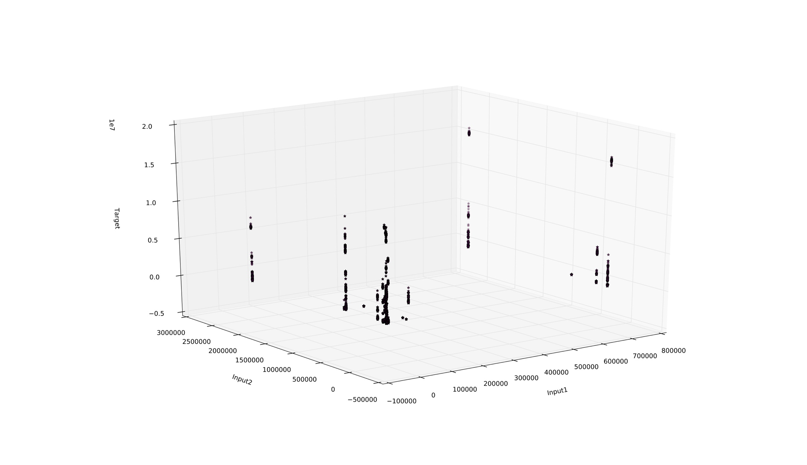
Targets vs Predictions by the 5 selected online learners
OCL_LEFTFETCHJOIN_GPU

Slide 44
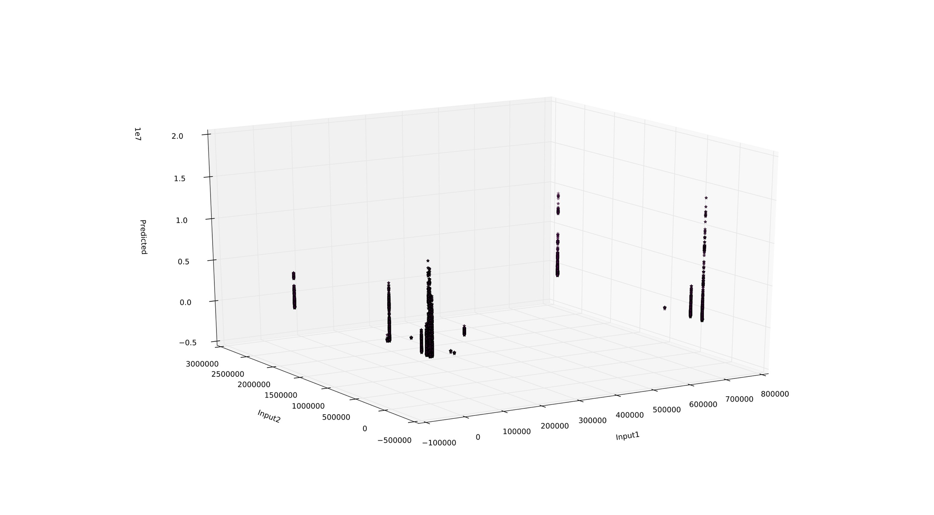
Targets vs Predictions by the 5 selected online learners
GPRegressionZeroMean_WS64 on OCL_LEFTFETCHJOIN_GPU

Slide 45
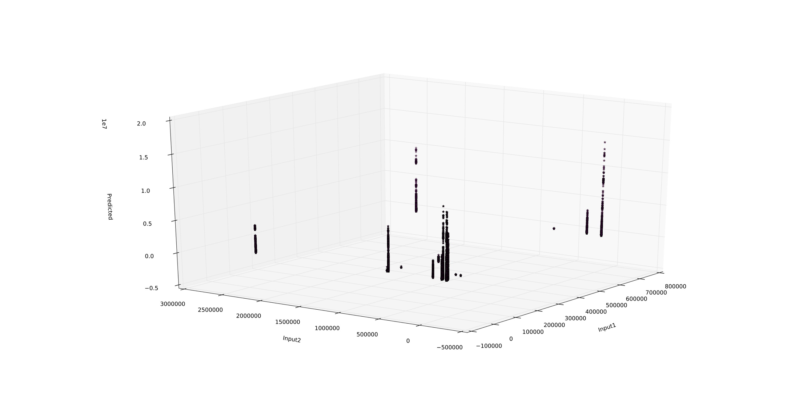
Targets vs Predictions by the 5 selected online learners
GPRegressionAvgMean_WS64 on OCL_LEFTFETCHJOIN_GPU

Slide 46
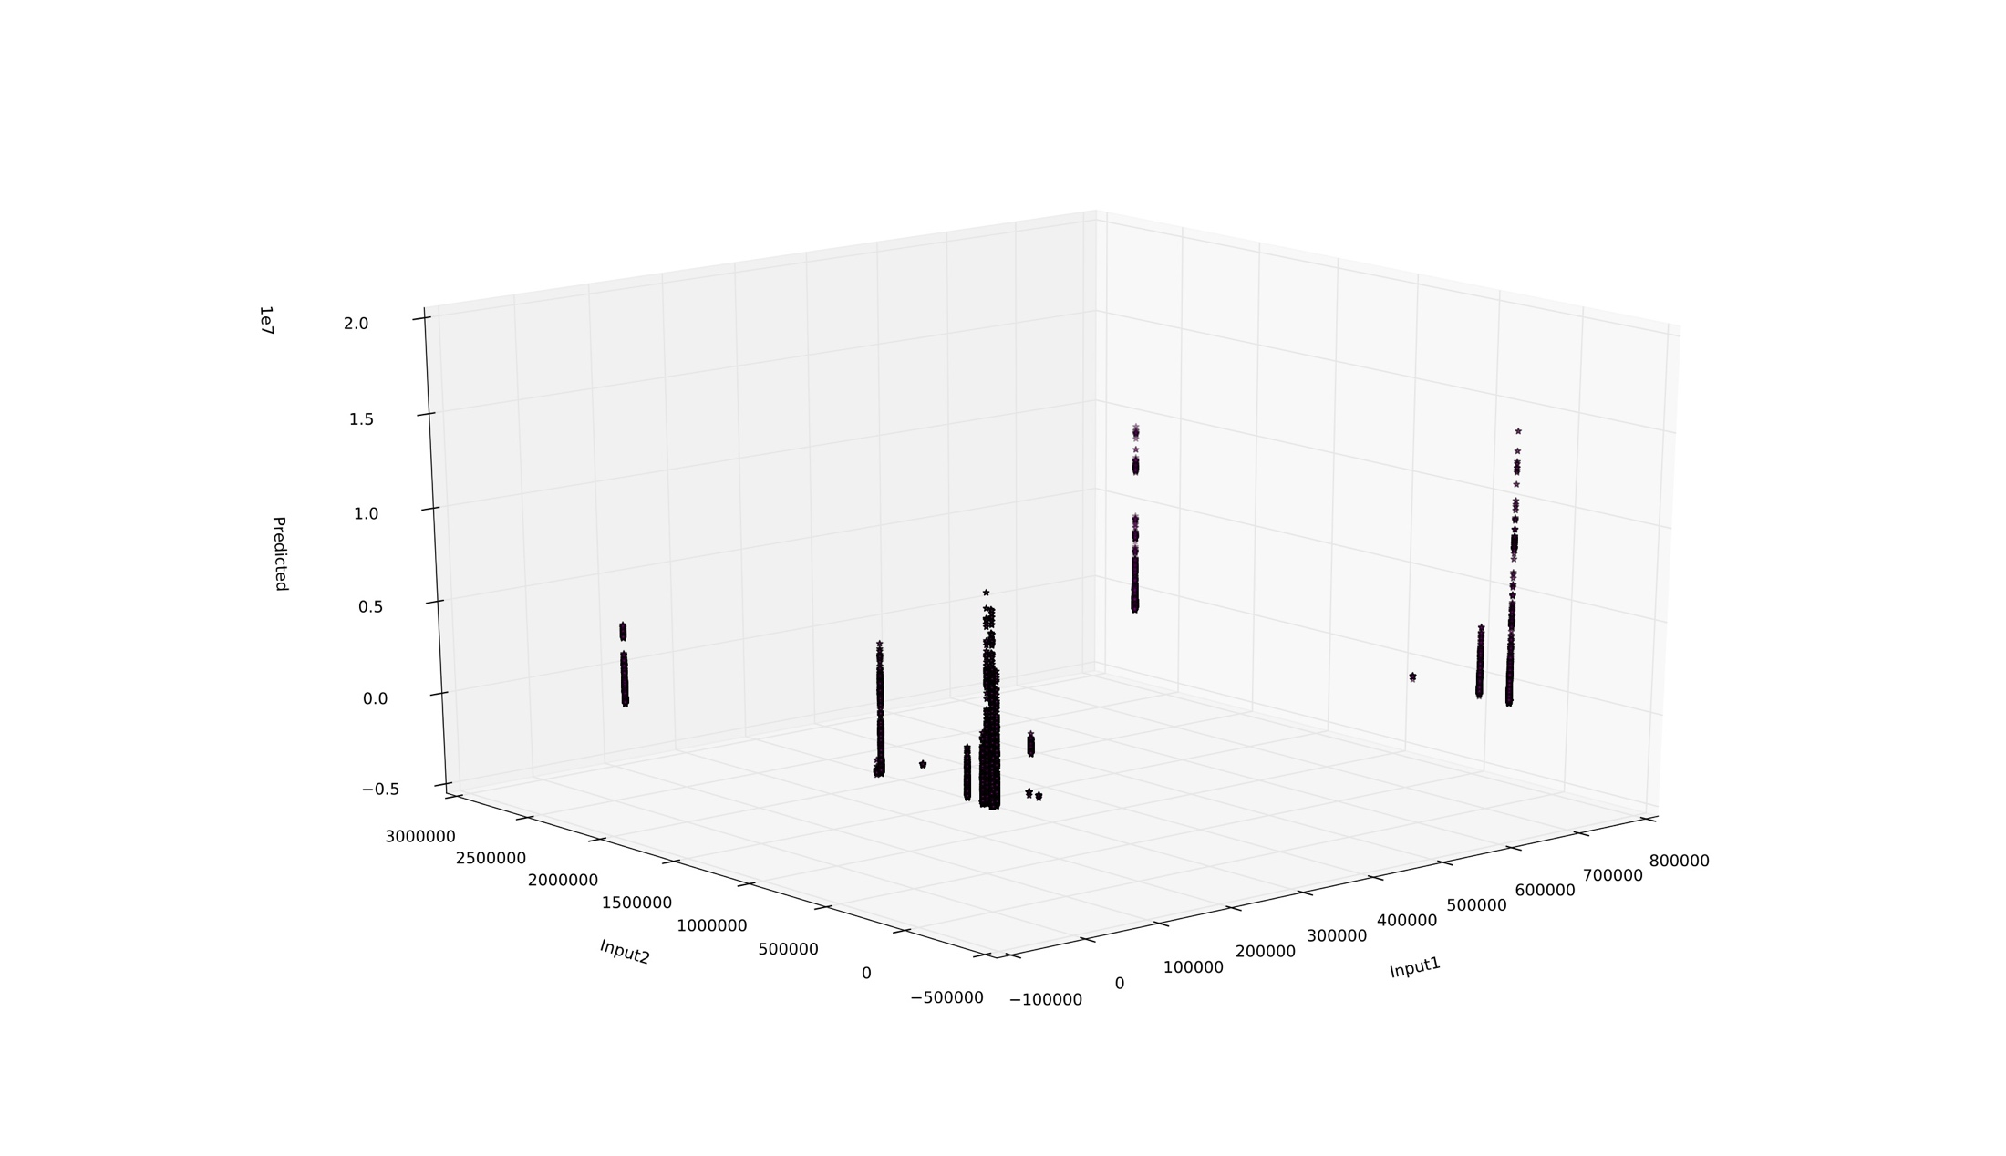
Targets vs Predictions by the 5 selected online learners
GPRegressionOLSMean_WS64 on OCL_LEFTFETCHJOIN_GPU

Slide 47
Targets vs Predictions by the 5 selected online learners
KernelRegression_WS64 on OCL_LEFTFETCHJOIN_GPU

Slide 48
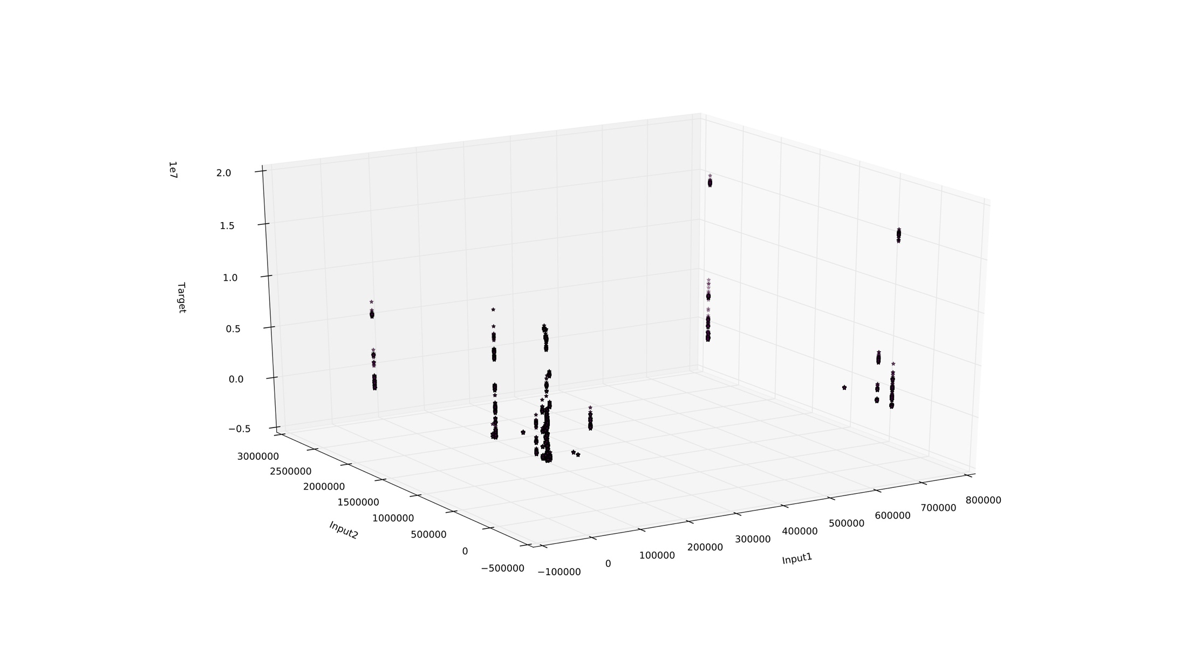
Targets vs Predictions by the 5 selected online learners
KernelRegression_WS96 on OCL_LEFTFETCHJOIN_GPU

Slide 49
Conclusion
Sliding-windowed non-parametric online learners are effective in learning from non-stationary data streams
Sliding-window size has major implications on accuracy and time efficiency
Forgetting-based parametric learners do not perform well on the drifting data
Finding good hyperparameter configurations is a challenging task
Notes:
Sliding-windowed non-parametric online learners are effective in learning from data streams with nonstationarities which makes them a good choice to be employed for building cost models for runtime prediction in Ocelot.
Sliding-window size has major implications on accuracy and time efficiency hence it should be chosen carefully
Forgetting-based parametric learners do not perform well on the drifting data
Finding good hyperparmeter configurations in the tuning is a challenging task

Slide 50
Algorithm Comparison Table
 | Accuracy | Prediction Bounds | Time Efficiency | Space Efficiency
MLE | + | + | +++ | +++
MAP | + | + | +++ | +++
GP Regression | +++ | +++ | + | ++
Kernel Regression | +++ | ++ | ++ | ++

Slide 51
Future Work
Online extension for Quantile Regression and SV-r
Prediction Bounds Estimation mechanism for SV-r
Notes:
In summary, there is significant amount of work yet to be done regarding online regression algorithms featuring prediction uncertainty estimation mechanism.

Slide 52
References
Carl Edward Rasmussen and Christopher K. I. Williams. Gaussian Processes for Machine Learning (Adaptive Computation and Machine Learning). The MIT Press, 2005. ISBN 0-262-18253-X.
Bernard W Silverman. Density estimation for statistics and data analysis, volume 26. CRC press, 1986.
Heimel, Max, et al. "Hardware-oblivious parallelism for in-memory column-stores." Proceedings of the VLDB Endowment 6.9 (2013): 709-720.
Joao Gama, Raquel Sebastiao, and Pedro Pereira Rodrigues. Issues in evaluation of stream learning algorithms. Proceedings of the 15th ACM SIGKDD international conference on Knowledge discovery and data mining - KDD ’09, pages 329–337, 2009. doi: 10.1145/1557019.1557060.

Slide 53
Questions?
Thanks for listening! ☺

